Slide 1
AI Flappy Bird
Group Member | Matric Number
Lee Yee Run | 17150694/1
Goh Jing Xuan | 17106478/1
Tan Chun Shui | 17110581/1
Tan Zhi Qin | 17166150/1

Slide 2
Problem Definition
Learning to play games with Artificial Intelligence (AI) had gained popularity in the research of AI
One of the hardest mobile game that became popular recently is Flappy Bird where human waste a lot of time to perfect its gameplay
The goal of the project is to develop an AI agent to play Flappy Bird game that can surpass human performance

Slide 3
Related Work
FlappyBird with Deep Reinforcement Learning (Naveen Appiah & Sagar Vare, 2016)
Q-learning - off-policy, use the bellman equation as an iterative update
deep Q-network (DQN) - using raw snapshots image as input
FlapAI Bird: Training an Agent to Play Flappy Bird Using Reinforcement Learning Techniques (Tai Vu & Leon Tran, 2020)
Q-learning with ε-greedy policy, discretization and backwards update
State–action–reward–state–action (SARSA) agents
Q-learning agents achieves highest in-game score of 2069
Notes:
State–action–reward–state–action (SARSA)

Slide 4
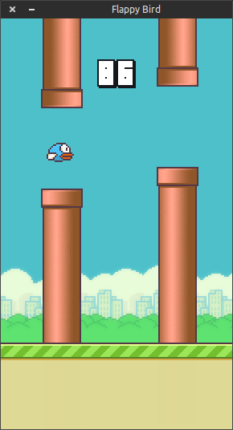
Environment and Simulation
Game environment
2 pipes will be generated randomly as obstacle
Constant value such as gravity to affect the bird
At any game time, there are 2 possible actions:
Jump upward when player hit the ‘up’ key
Descend with constant rate when player does not press any key
The score will be incremented by one when the bird cross the gap between the pipes
If the bird touch the pipes or ground, then game over.
Base game chosen: FlapPyBird https://github.com/sourabhv/FlapPyBird

Slide 5
Proposed Approach
Genetic Algorithm with Multilayer Perceptron MLP
Gene pool size: 50
Fitness function is defined as follows:
Reward 1 for each pixel travelled horizontally
Reward 50 for each pipe passed
Penalized by dividing two if the model's bird goes off-screen, hit the ground or is the first n birds to hit a pipe. Value of n is half of pool size
Elitism: Best performing model is always passed to the next generation
Parent selection method: roulette wheel selection
Parent cross over method: Uniform crossover (each weight value is randomly swapped between two parents)
Mutation rate: 0.15 for the first half generations, 0.1 for the second half generations
Mutation change: each weight value is either increased or decreased by a random percentage

Slide 6
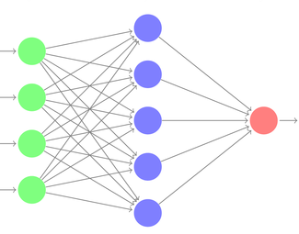
Proposed Approach
Genetic Algorithm with Multilayer Perceptron MLP
Horizontal distance to next pipe
Vertical distance to next pipe
y-velocity of bird
Height Difference between next 2 pipes
Jump Probability

Slide 7
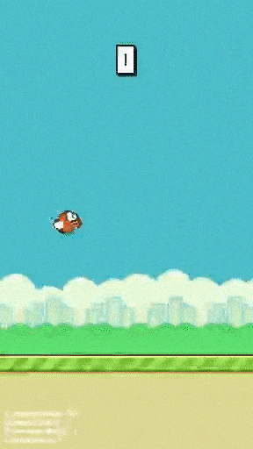
Experiments
Phase 1
At the initial phase, all models are randomly initialized and thus perform random actions and does not even pass through the first pipe

Slide 8
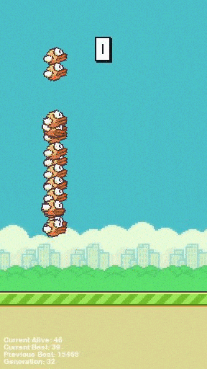
Experiments
Phase 2
After some times, a few models successfully mutate into better models that are able to jump through pipes.
These models have higher chance to be selected as parents during cross over and the gene pool steadily becomes better at playing the game.

Slide 9
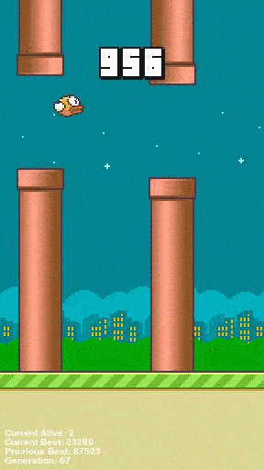
Experiments
Phase 3
At the final phase, every model in the gene pool are able to play the game well achieving scores above 100.
The best model achieves the maximum score above 1000 and the algorithm stops there.

Slide 10
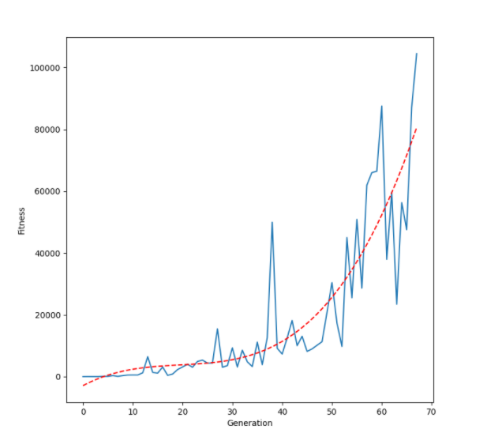
Result
Plot demonstrate how fitness value improves through generations.
The red-dotted line shows the general trend of the fitness value.
Some small fluctuation are seen in the graph because of random mutation and also because of the randomness in the flappy bird game

